Slide 1

Housing Smurfs
Team 0507-07
Wei-Yu Jen
Bharath Kumar Routhu
Shih-Siang Lin
Vishal Vindyala
Wen Chen
Housing
Smurfs
12.06.2021

Slide 2

Agenda
Background & Introduction
Conceptual Database Design
Logical Database Design
Physical Database Design
Use Case & Applications
Future Work
Housing
Smurfs

Slide 3


Background
We aim to help UMD Members find their dream unit!
Check reviews from different sources and rental details on Housing Smurfs, and welcome to leave a review for your unit to help other UMD members.
Google Ratings
Official Website Info
Housing
Smurfs
OCH Info
Reviews From Other Website
Notes:
Housing Smurfs is targeting to the UMD members, such as students, faculty, and their dependents. We aim to help them find their dream unit near to the campus. Many of us must understand how struggled and frustrated it might be when trying to find a suitable place to stay. For each single unit, you need to look everywhere for rates, information, and reviews for that unit, which is such a time consuming and annoying process.
Luckily, with Housing Smurfs, now you can easily check reviews, rates, and rental details all at once! And after you become a resident, you can also leave a review to help other UMD members.

Slide 4

Collect reviews and rental details from different online sources to Housing Smurfs
Introduction
See all the units you can choose near the UMD
What are the unit’s name, rate, rent per person, number of bedrooms and bathrooms, number of reviews, and contact info for every unit near the UMD?
Understand general conditions about these units
What is the average rate for the units that the UMD shuttle bus will stop by?
What is the percentage of reviewers that left rate >=4.0 starts for Graduate Hills?
Which units meet your expectations?
Which apartment is less than 1 mile to the UMD, has rent equal to or lower than $1,400, and with a study room at the same time?
What are the good reviews say about that unit?
What is the review content for that unit which is >=4.0?
Housing
Smurfs
Notes:
By collecting reviews of various units and their rental details from different online sources to Housing Smurfs, we promise that we can solve some most common problems you might have when searching for a unit.
First, what options do you have? What kind of units are there near the campus?
Follow by that, which unit meet your expectations?
And for that one, do other people also think it is a good unit?
It is our goal to answering all these questions.
For the database design part, I’ll pass to Wen Chen to introduce the conceptual database design

Slide 5

Database Design
Housing
Smurfs

Slide 6
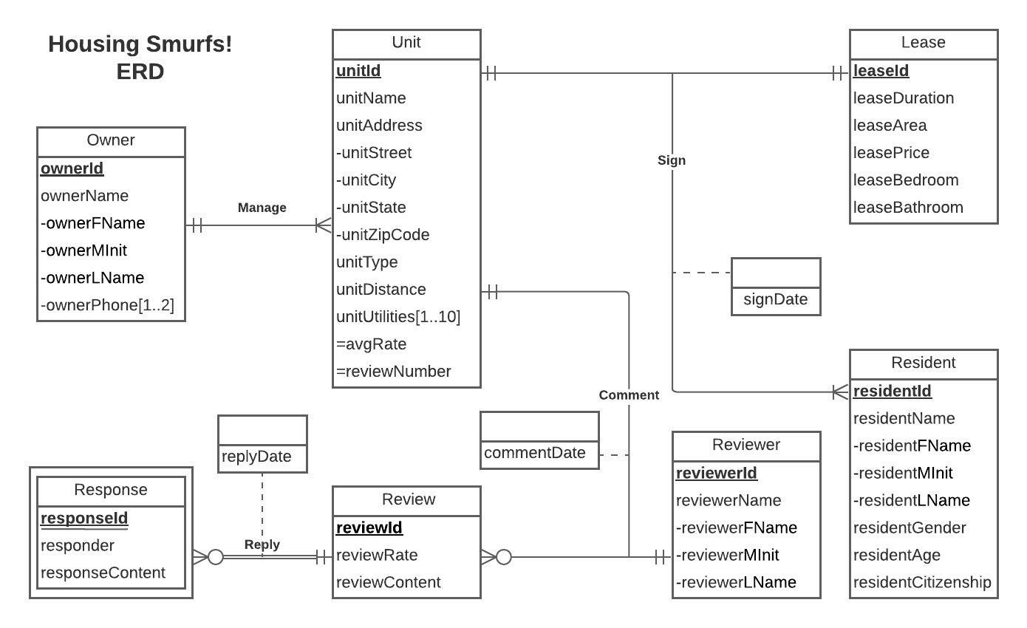
Conceptual Database Design

Slide 7
Logical Database Design
Owner (ownerId, ownerFName, ownerMInit, ownerLName)
Unit (unitId, unitName, unitStreet, unitCity, unitState, unitZipCode, unitType, unitDistance, ownerId)
Unit_Utilities (unitId, unitUtilities)
Owner_Phone (ownerId, ownerPhone)
Lease (leaseId, leaseDuration, leaseArea, leasePrice, leaseBedroom, leaseBathroom)
Resident (residentId, residentFName, residentMInit, residentLName, residentGender, residentAge, residentCitizenship)
Reviewer (reviewerId, reviewerFName, reviewerMInit, reviewerLName)
Review (reviewId, reviewRate, reviewContent)
Response (reviewId, responseId, responder, responseContent, replyDate)
Sign (residentId, leaseId, unitId, signDate)
Comment (reviewId, unitId, reviewerId, commentDate)
Housing
Smurfs

Slide 8
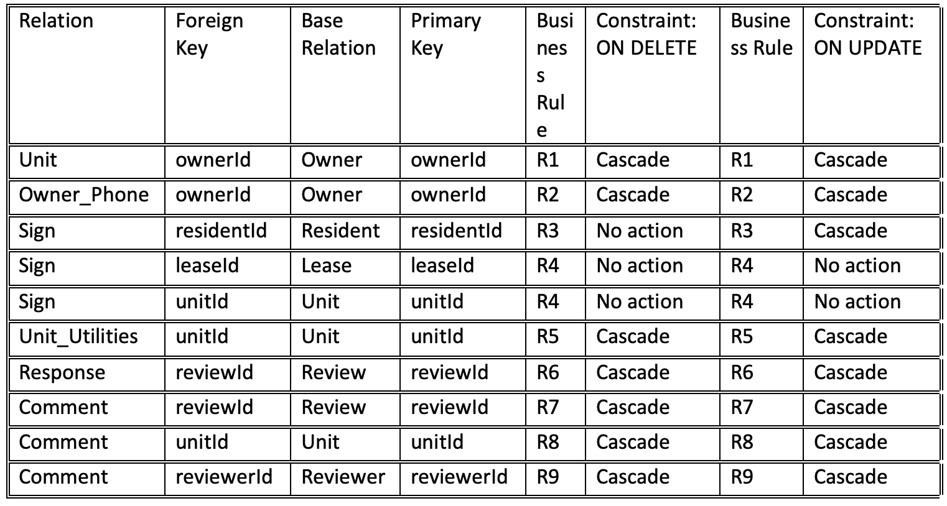
Logical Database Design
Referential Integrities

Slide 9
Logical Database Design
.
[R1] When Owner information is changed or deleted, the corresponding owned unit information should be changed or deleted accordingly
[R2] When Owner information changed or deleted, the owner’s phone numbers should be changed or deleted accordingly
[R3] When a lease is signed by a resident, for an unit, the information of the resident cannot be deleted but can be changed accordingly
[R4] When a lease is signed by a resident, for an unit, the unit and the lease agreement cannot be changed or deleted
[R5] When the information of the unit is changed or deleted, the information regarding the unit utilities should be changed or deleted accordingly
[R6] When the information of a review are changed or deleted, the information of the response to the review should also be changed or deleted
[R7] When the information of a review is changed or deleted, the information of the comments on the review should also be changed or deleted accordingly.
[R8] When the information of a unit is changed or deleted, the comments about the unit should also be changed or deleted
[R9] When the information of a reviewer is changed or deleted, the comments from the reviewer should also be changed or deleted
Business Rules

Slide 10
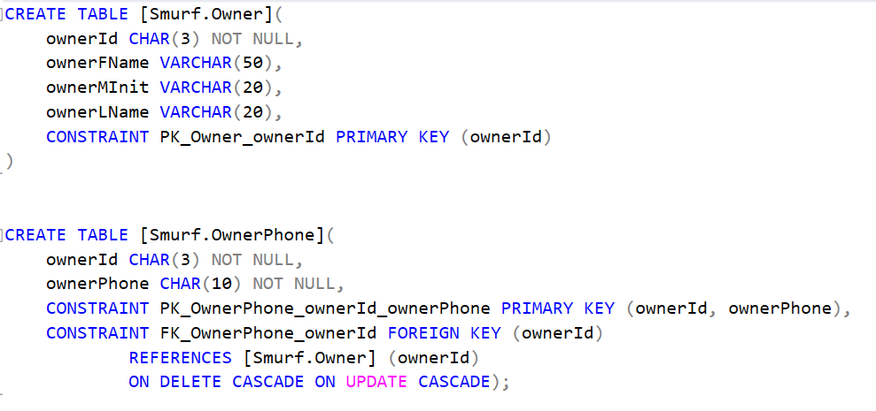
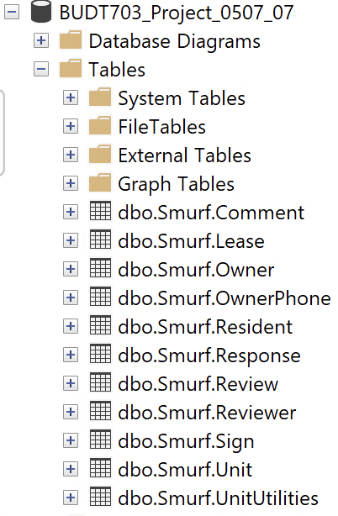

Physical Database Design
Housing
Smurfs

Slide 11
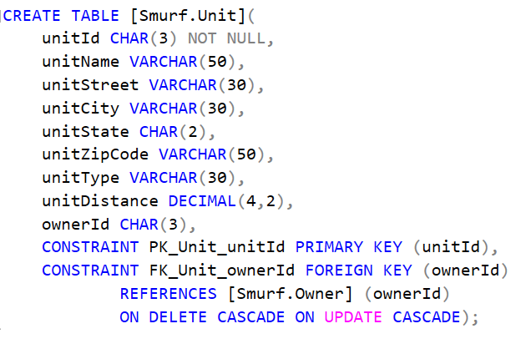
Physical Database Design
Housing
Smurfs

Slide 12
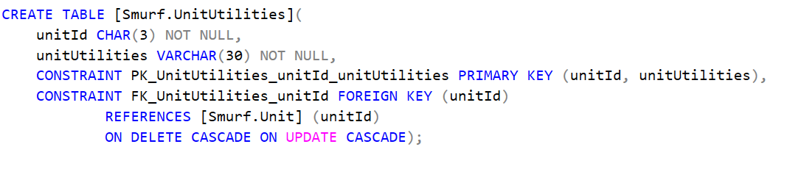
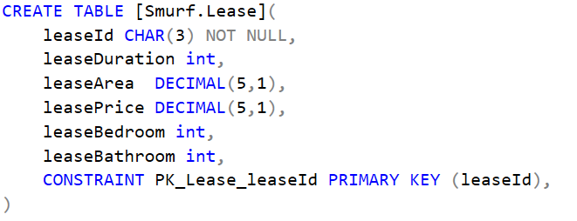
Physical Database Design
Housing
Smurfs

Slide 13
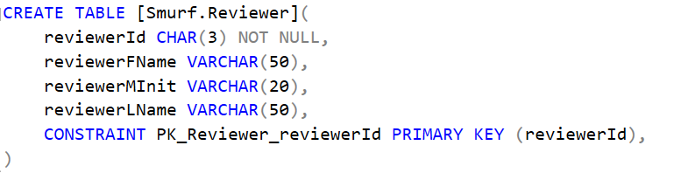
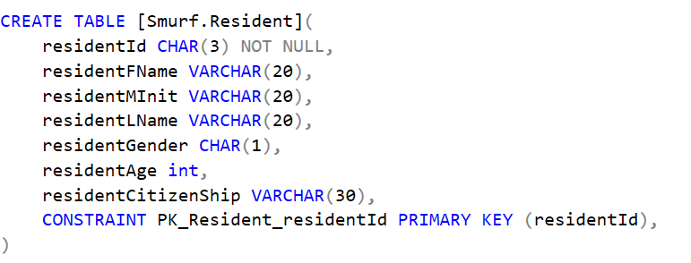
Physical Database Design
Housing
Smurfs

Slide 14
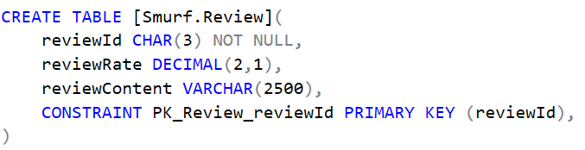
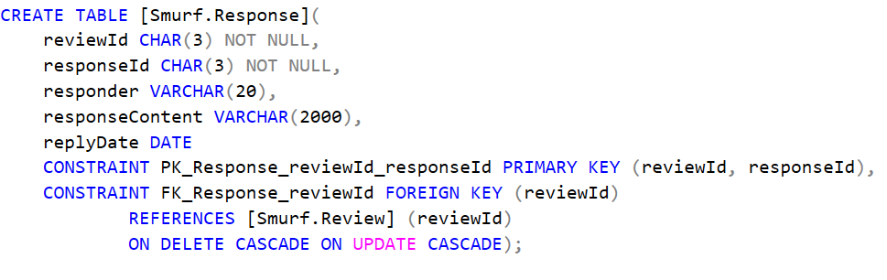
Physical Database Design
Housing
Smurfs

Slide 15
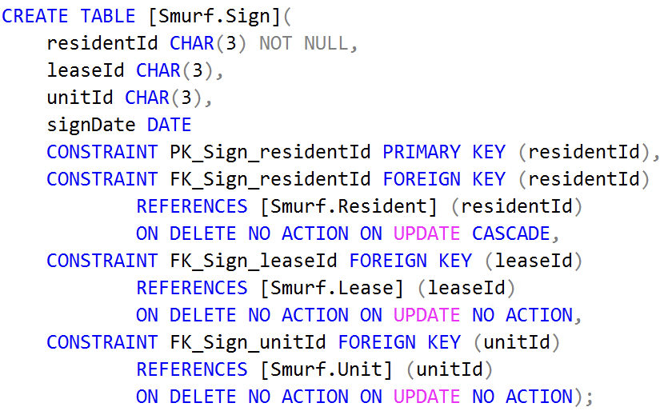
Physical Database Design
Housing
Smurfs

Slide 16
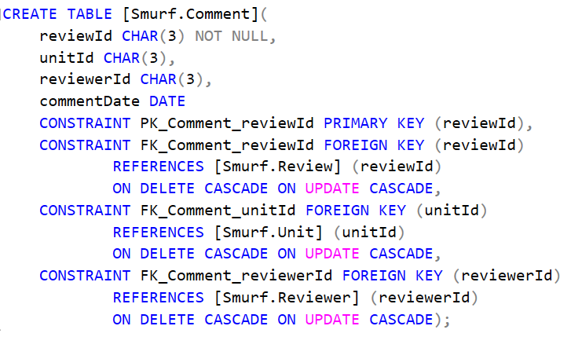
Physical Database Design
Housing
Smurfs

Slide 17
Data Collection
Housing
Smurfs
Lease Information and Customer review - Collected from Google forms :
Housing Survey
Unit, Owner details - Taken from the Official sites
Reviews - collected from multiple sites like OCH database, Google
We have created the database to allow incorporation of reviews on any existing unit.
And to avoid any faulty reviews each reviews is linked to a unit which has all the required details. Thereby, we have separate reviews for all the different option available in the unit

Slide 18

Use Cases
&
Application

Slide 19
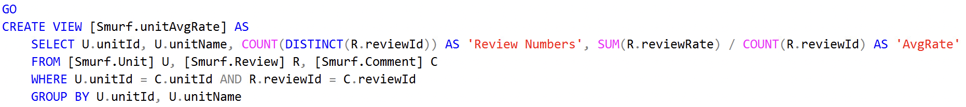
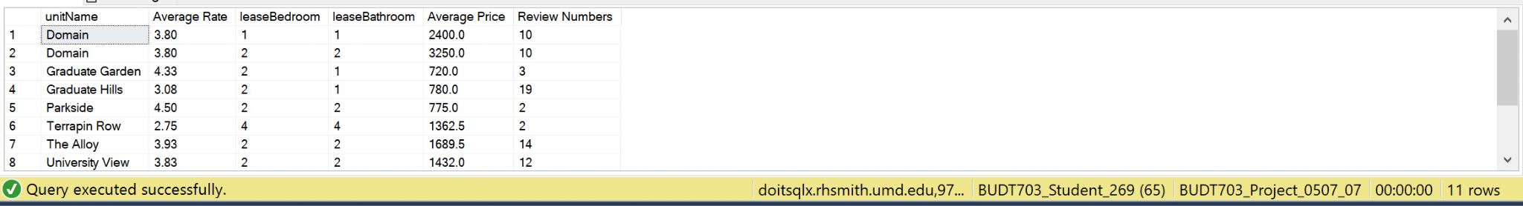
What are the unit name, rate, number of bedrooms and bathrooms, rent per person, number of reviews, and contact info for every unit?

Slide 20
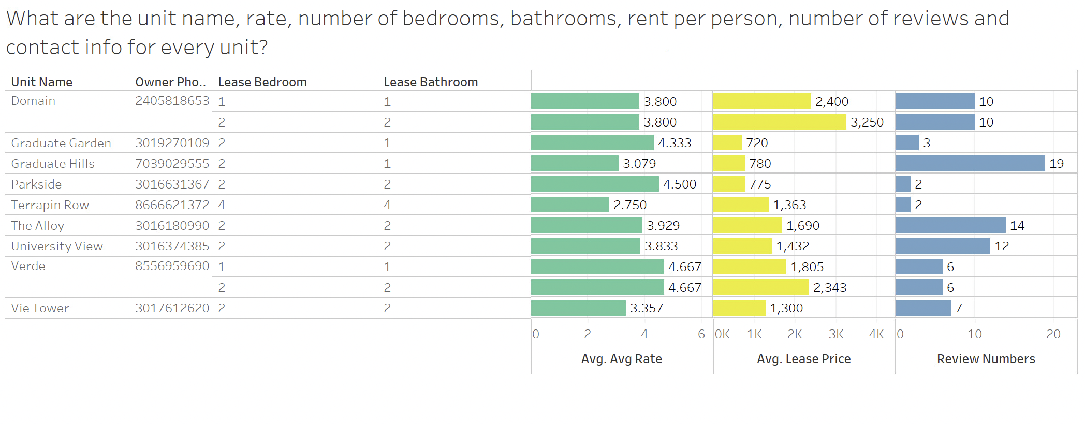
What are the unit name, rate, number of bedrooms and bathrooms, rent per person, number of reviews, and contact info for every unit?

Slide 21
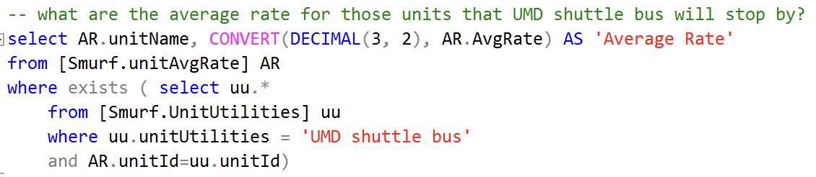
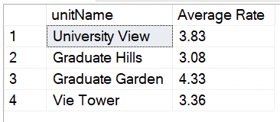

For all the apartments that the UMD shuttle will pass, what’s the average rate?
Housing
Smurfs

Slide 22
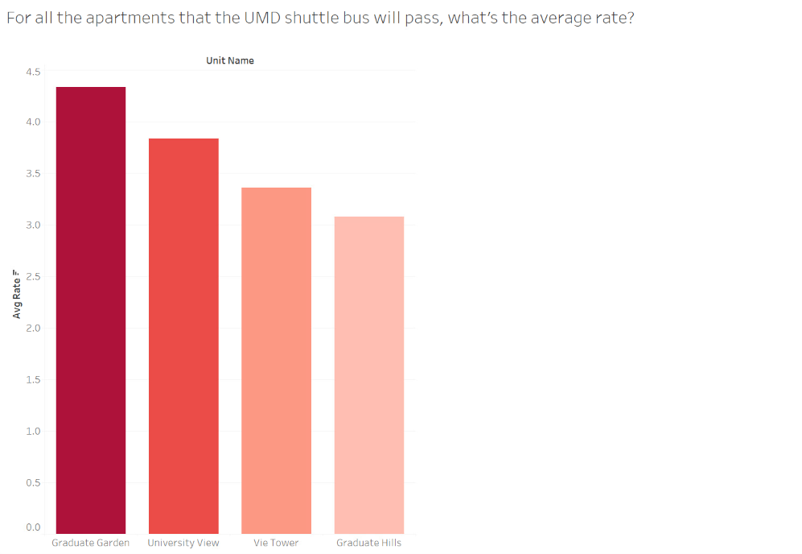
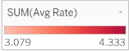
For all the apartments that the UMD shuttle will pass, what’s the average rate?
Housing
Smurfs

Slide 23
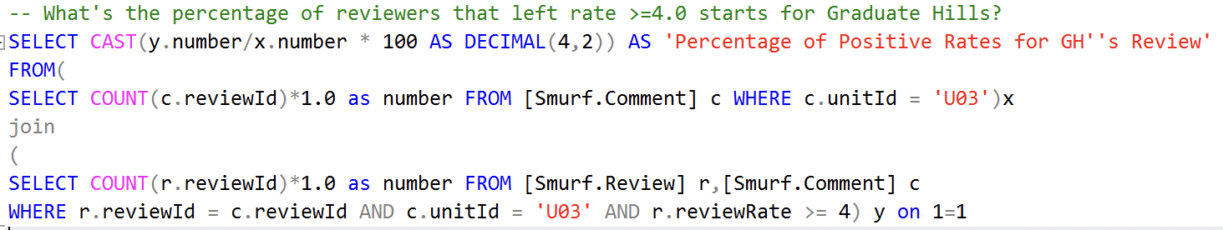
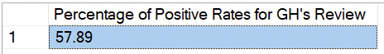
What’s the percentage of reviewers that left rate >= 4.0 starts for Graduate Hills?
Housing
Smurfs

Slide 24
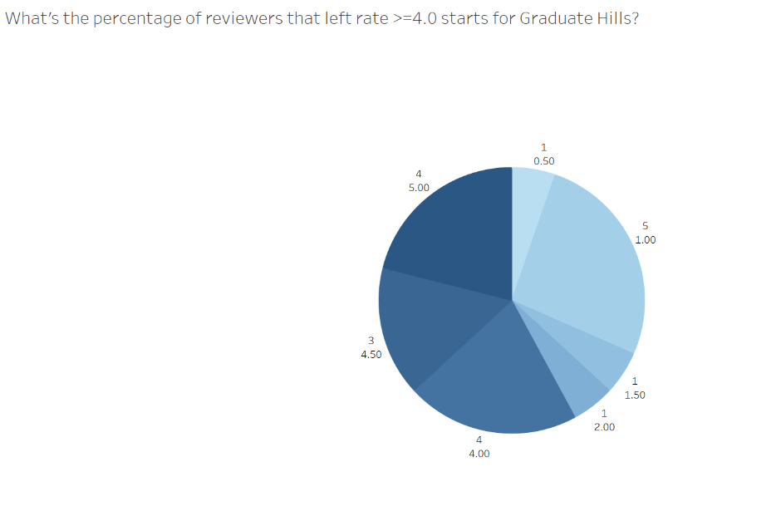
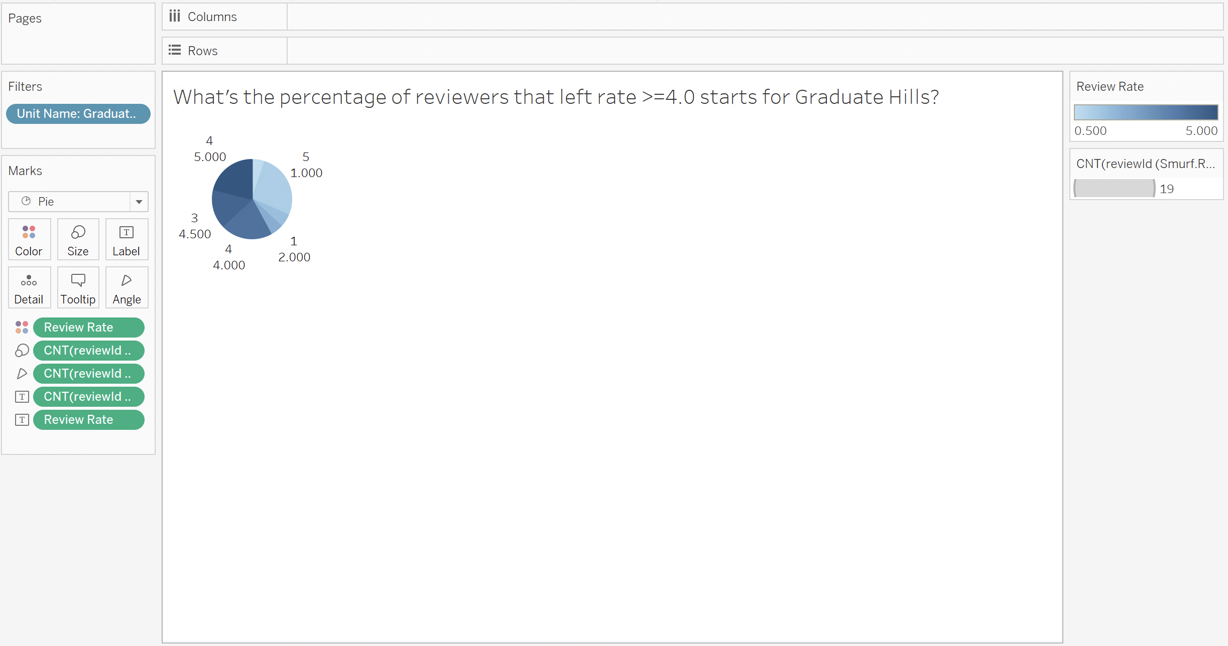
What’s the percentage of reviewers that left rate >= 4.0 starts for Graduate Hills?
Housing
Smurfs

Slide 25
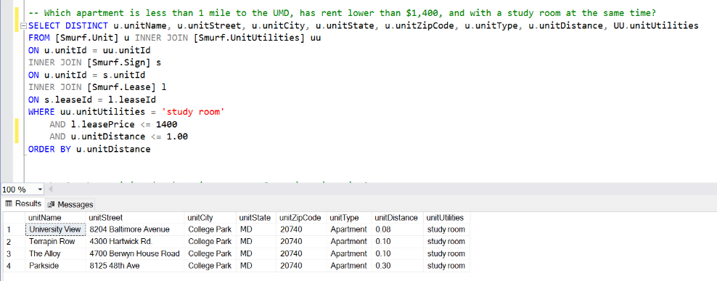
What apartments are less than 1 mile to the UMD, have rent lower than $1,400, and with a study room?

Slide 26
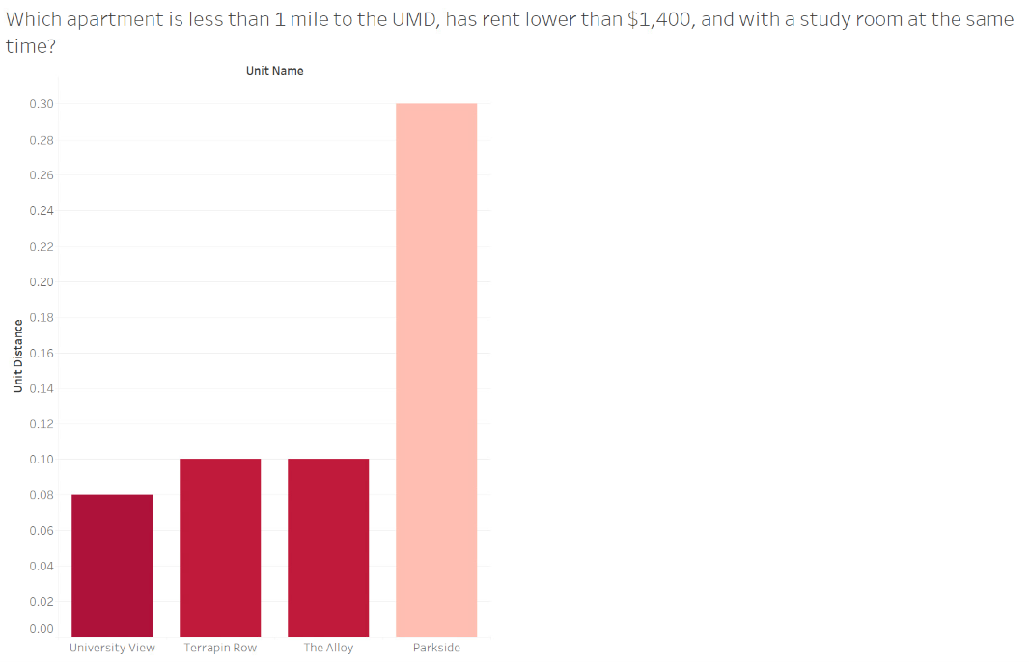
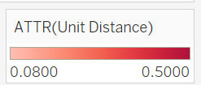
What apartments are less than 1 mile to the UMD, have rent lower than $1,400, and with a study room?
Notes:
What are the rates for the units that are less than 1 mile to …...l

Slide 27
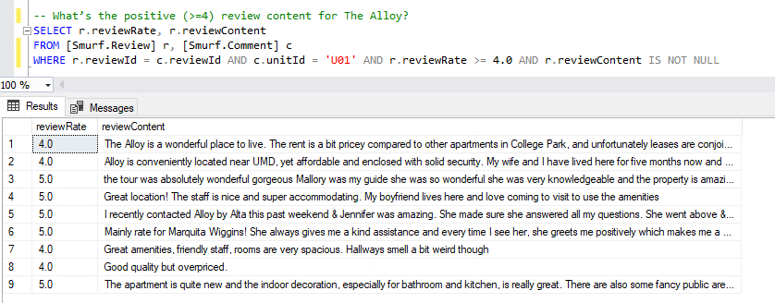
What are the contents of the reviews for The Alloy that have rate equal or greater than 4.0?
Housing
Smurfs

Slide 28
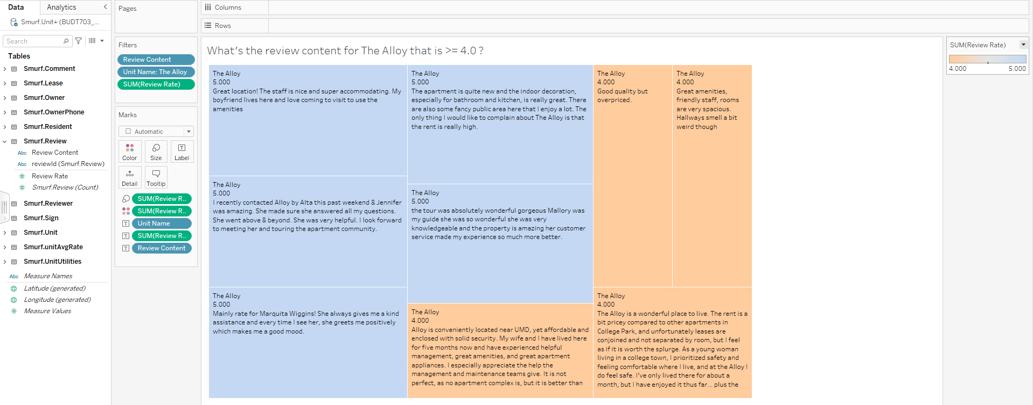
What are the contents of the reviews for The Alloy that have rate equal or greater than 4.0?
Housing
Smurfs

Slide 29
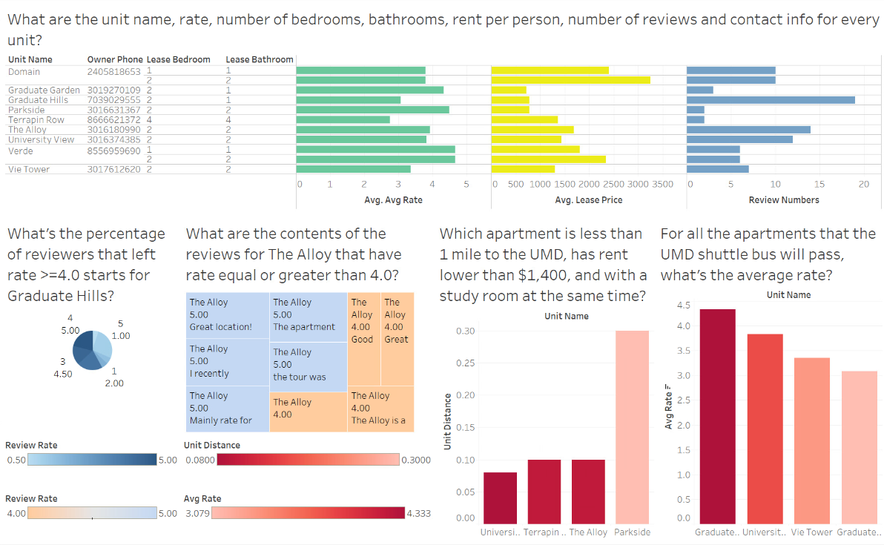
Dashboard
Housing
Smurfs

Slide 30
Future Work
Increase the scale and quantity of data
Use other methods to collect and import data to the database
User-Friendly interface

Slide 31

Thank you!
Team 0507 - 07
Q & A
Housing
Smurfs

